Slide 1

CS2009- Design and Analysis of Algorithms Lecture 3
Course Supervisor: Anaum Hamid

Slide 2
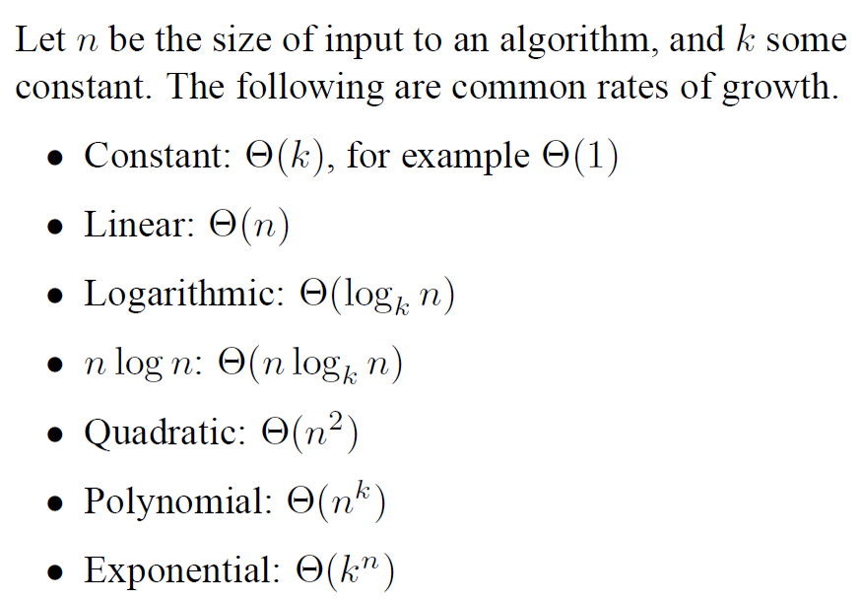
Growth of Functions : Complexity of algorithms

Slide 3
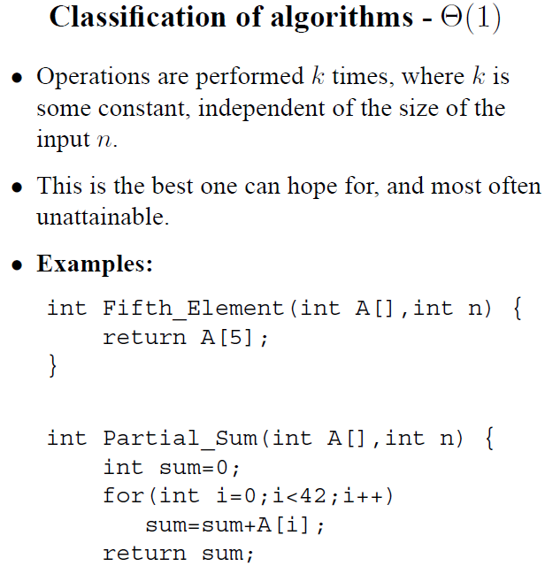

Slide 4
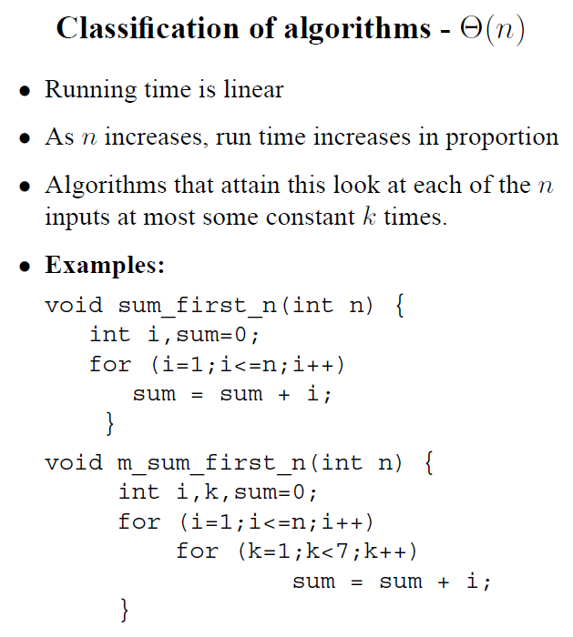

Slide 5
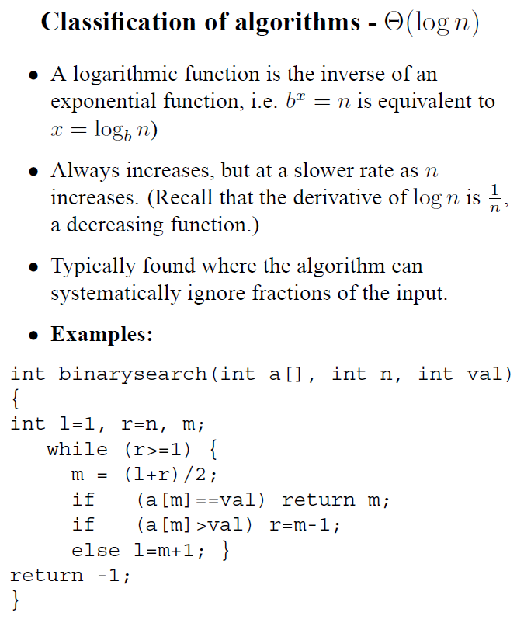

Slide 6
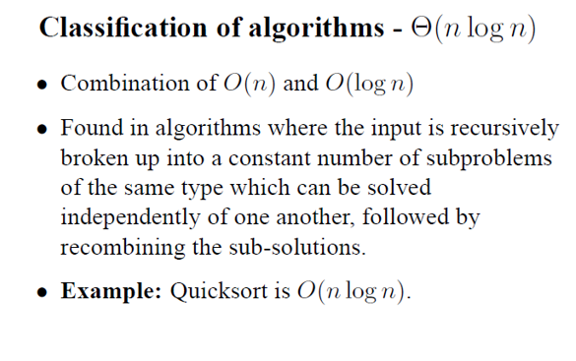

Slide 7
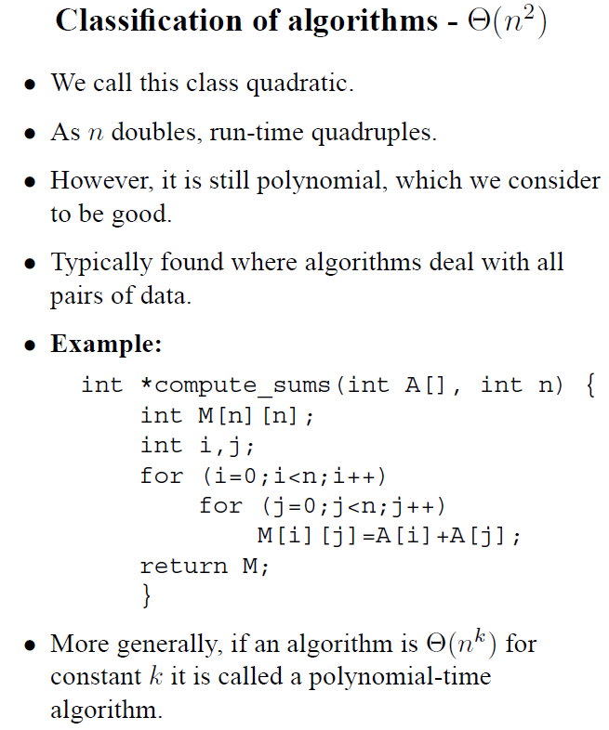

Slide 8
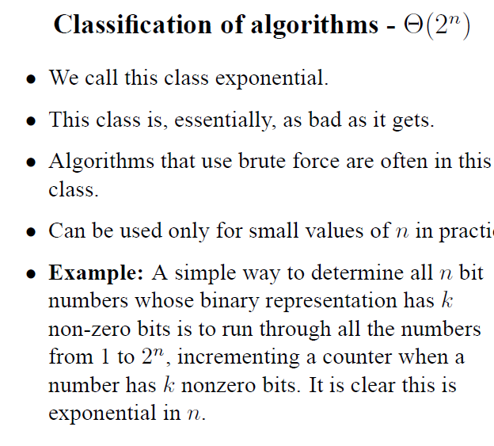
Example Explanation :
If n=2, we need to check all possible binary representations that have 2 bits.
For n=2, then total binary representations that will have 2 bits = 2^n = 2^2 = 4
Means there will be total 4 combinations which are:
00 01 10 11
Now if we want to find non zero bits in each of these 4 combination, then we need to check all 4 which means we need to check 2^n times so it is 2^n type algorithm.

